Slide 1
Childhoold Pneumonia Detection
Rebecca Mih

Slide 2
Pneumonia is the world’s leading infectious killer of children, claiming the lives of more than 800,000 children under the age of five every year, more than 2,000 every day.
These deaths are preventable
Unicef, 2019
Notes:
This is the question that your experiment answers

Slide 3
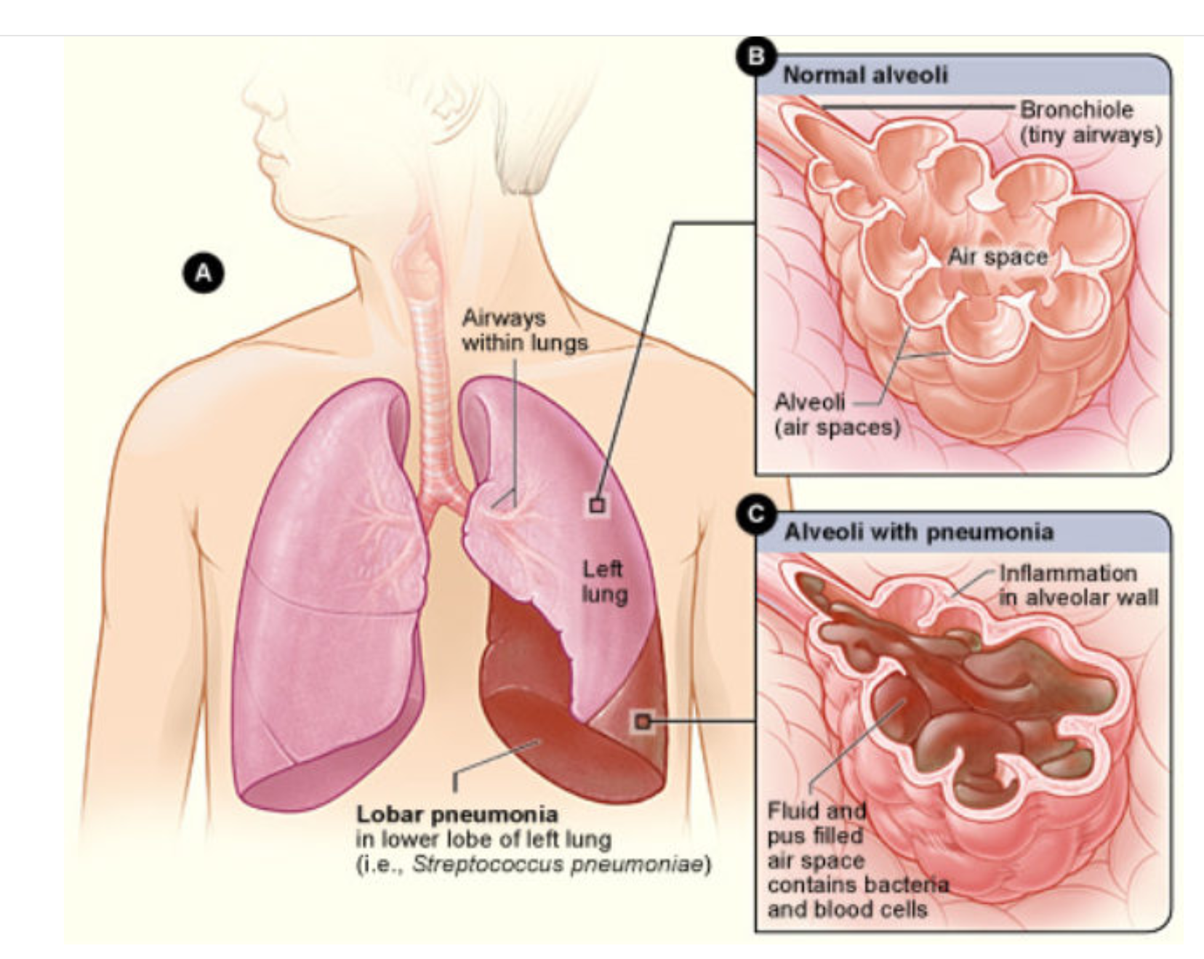
What is Pneumonia in Children
Pneumonia is an infection at the end of the airways, where the airsacs (alveoli ) fill with fluid and pus making breathing difficult, or painful
Most often caused by bacteria, viruses or fungi.
Bacterial pneumonia must be treated timely with antibiotics
This project uses neural networks to classify whether an chest x-ray of a sick child indicates pneumonia (either bacterial or viral)
Childhood Pneumonia JAMA. 2017;318(5):490. doi:10.1001/jama.2017.9428

Slide 4
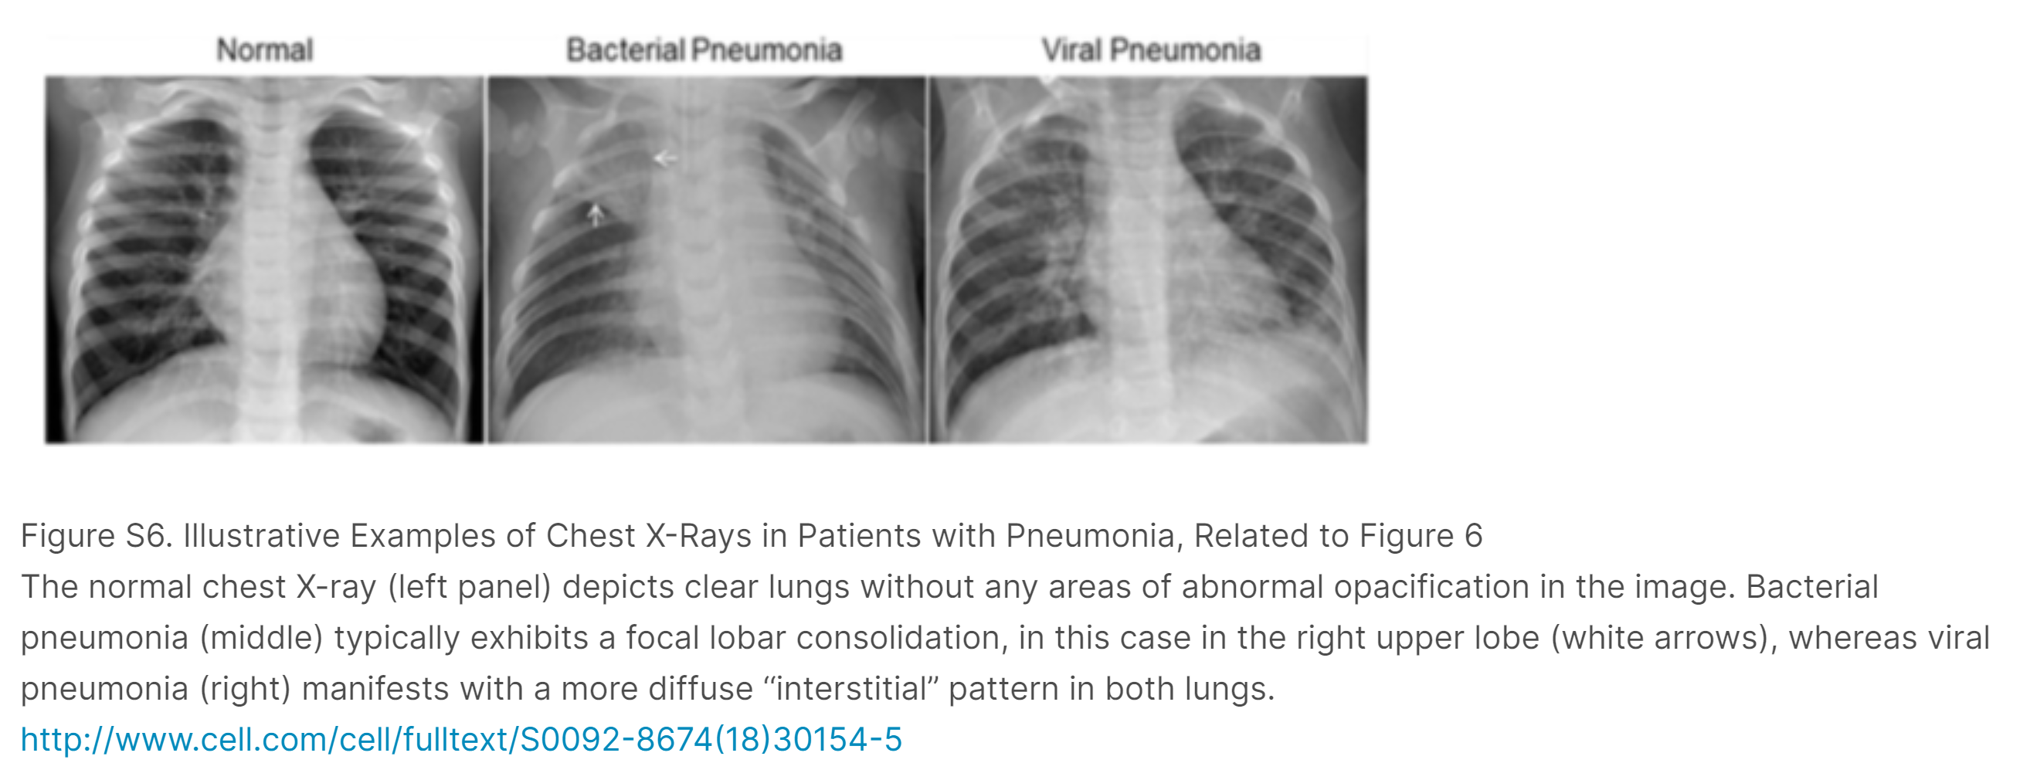
Business Objective: To Improve Treatment through Fast and Accurate Diagnosis
Reading chest x-rays requires significant skill
Childhood pneumonia is most prevalent in countries with limited skilled physicians and nurses to read chest xrays when available (Nigeria, India, Pakistan)

Slide 5
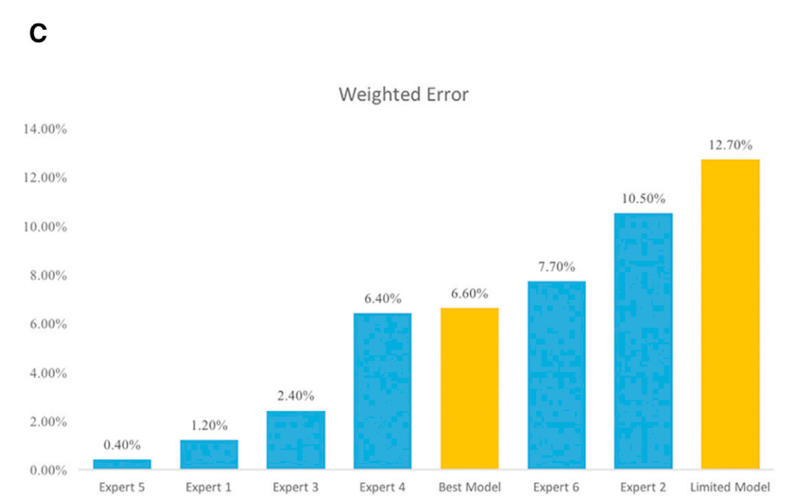
Business Objective: To Improve Treatment through Fast and Accurate Diagnosis (cont’d)
Comparisons to human reading of charts shows a large variation in skill
With the availability of cellular connectivity, one can imagine the ability to upload images for remote computer-aided diagnostic, used for pre-screening or a “second option”
Freeing up valuable medical resource time, while potentially improving accuracy
Yellow = model values
Blue = human experts
Notes:
https://data.mendeley.com/datasets/rscbjbr9sj/2
Kermany, Daniel; Zhang, Kang; Goldbaum, Michael (2018), “Labeled Optical Coherence Tomography (OCT) and Chest X-Ray Images for Classification”, Mendeley Data, v2http://dx.doi.org/10.17632/rscbjbr9sj.2
;
Latest version is V3: Kermany, Daniel; Zhang, Kang; Goldbaum, Michael (2018), “Large Dataset of Labeled Optical Coherence Tomography (OCT) and Chest X-Ray Images”, Mendeley Data, v3http://dx.doi.org/10.17632/rscbjbr9sj.3

Slide 6
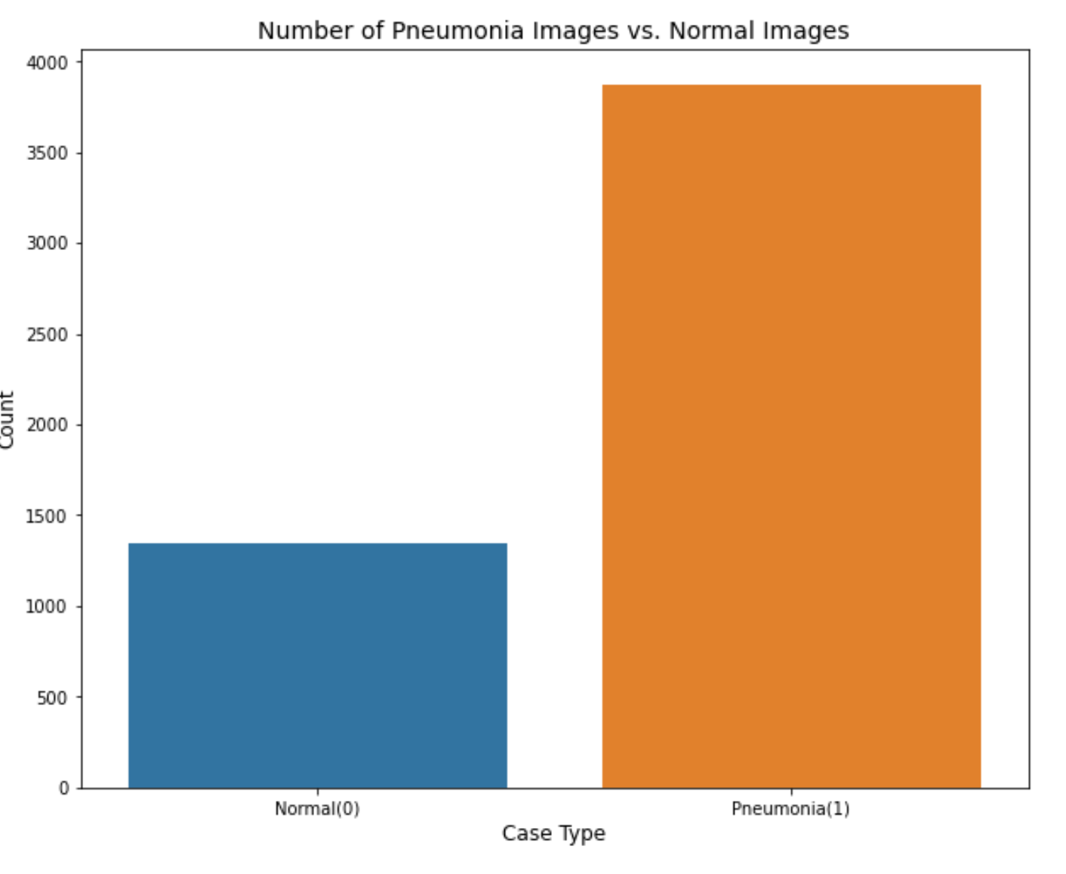
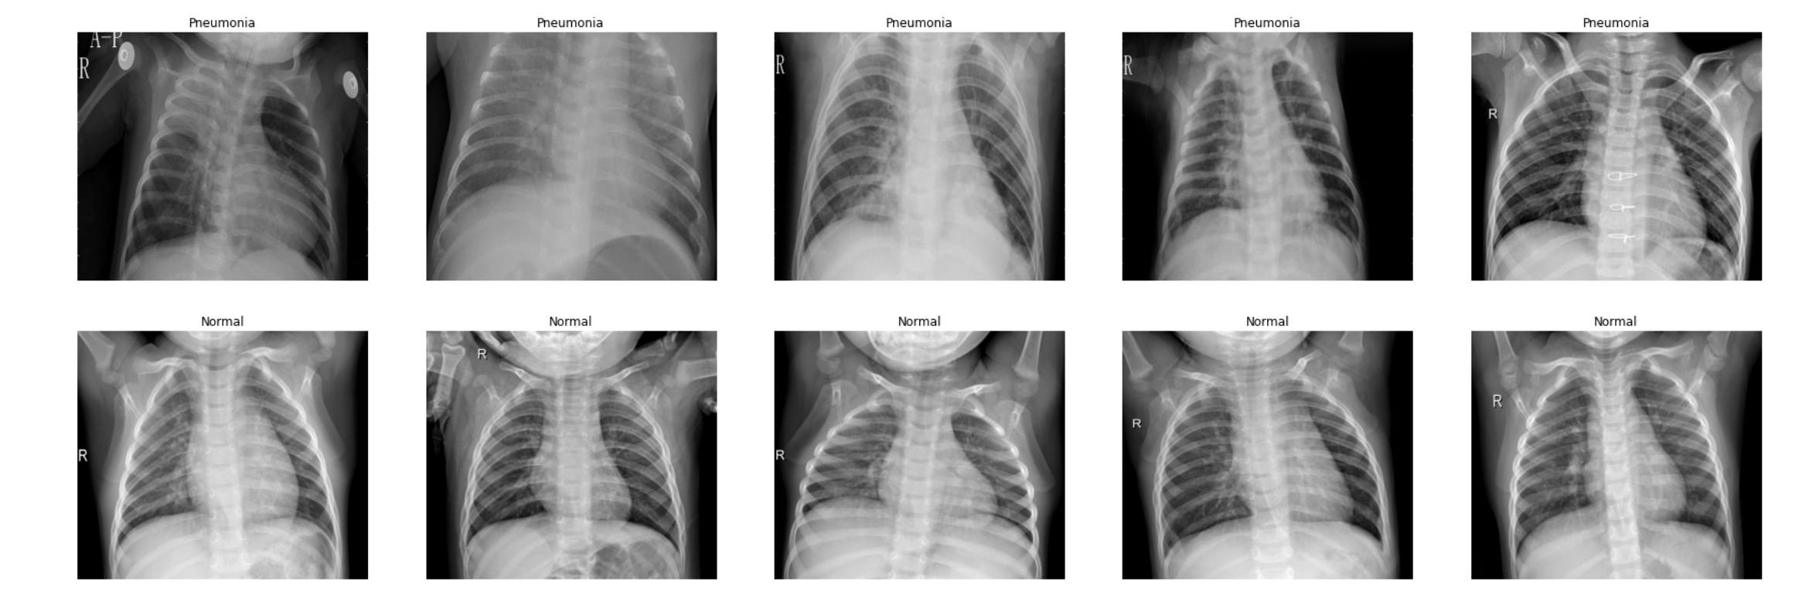
Description of the Dataset
3875 images of children with pneumonia
1341 images of children without pneumonia
Notes:
Latest version is V3: Kermany, Daniel; Zhang, Kang; Goldbaum, Michael (2018), “Large Dataset of Labeled Optical Coherence Tomography (OCT) and Chest X-Ray Images”, Mendeley Data, v3http://dx.doi.org/10.17632/rscbjbr9sj.3

Slide 7
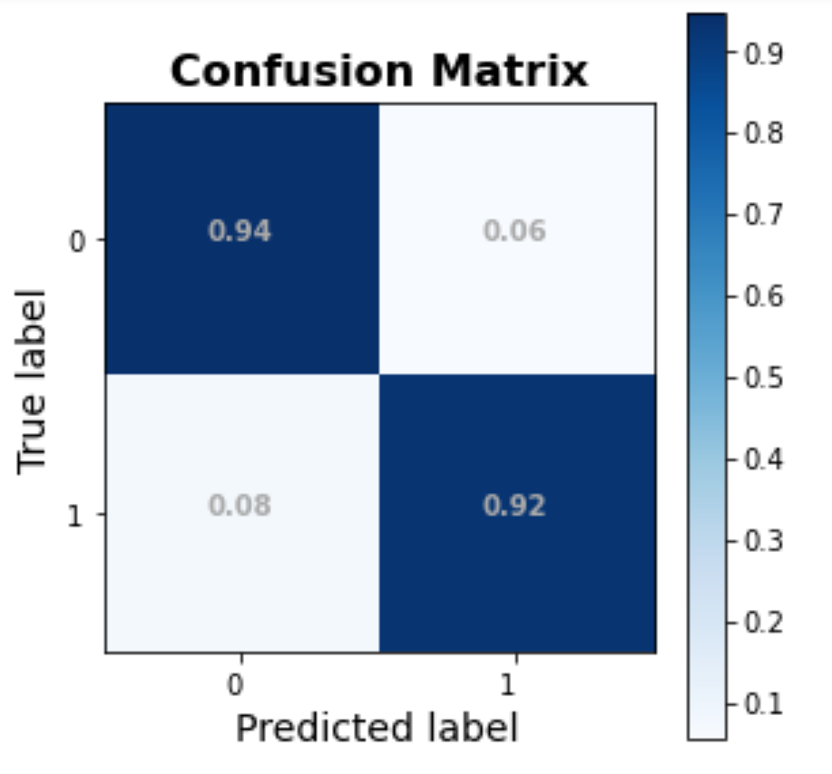
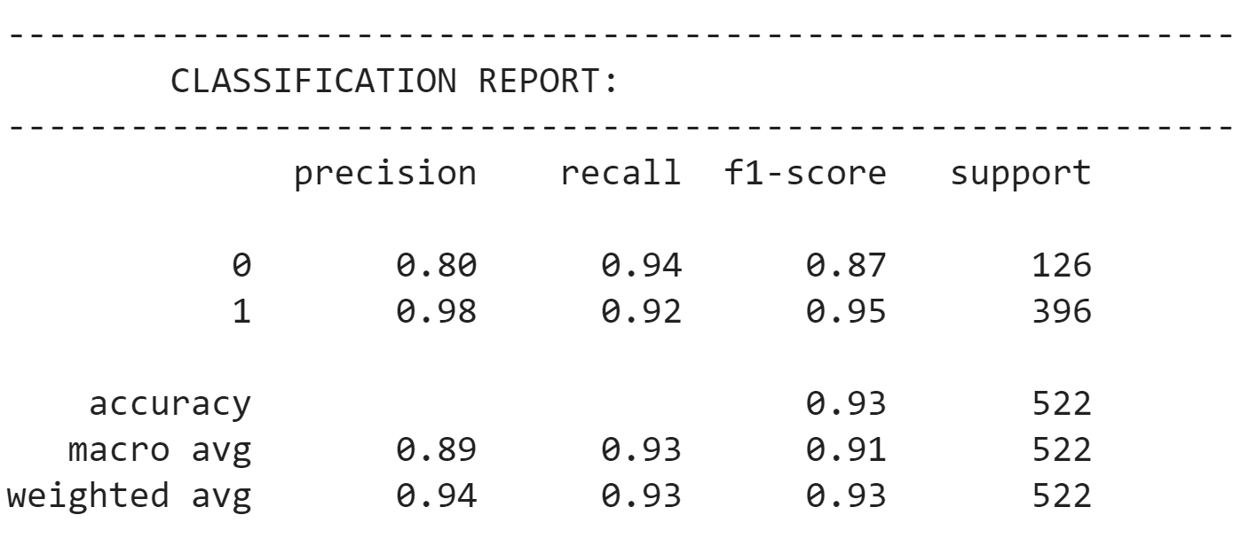
Results (updates to labels to be done)
Accuracy of 93%
The accuracy for those with pneumonia is 92%, while the accuracy for those without pneumonia is 94%
1 = has pneumonia
0 = doesn’t have pneumonia
Notes:
Summarize your research in three to five points.

Slide 8
Variables
Controlled variables
Independent variable
Dependent variable
The one variable you purposely change and test
The measure of change observed because of independent variable
Decide how you will measure the change

Slide 9
Add your answer / solution here
Hypothesis
Notes:
Establish hypothesis before you begin the experiment. This should be your best educated guess based on your research.

Slide 10
Materials
Materials (detailed list) | Quantity (be specific)
Item | Amount
Item | Amount
Item | Amount
Item | Amount
Item | Amount
Item | Amount
Item | Amount

Slide 11
Procedure
Step 1
Describe this step in your experiment
Step 2
Describe this step in your experiment
Step 3
Describe this step in your experiment
Step 4
Describe this step in your experiment
Notes:
List all of the steps used in completing your experiment.
Remember to number your steps.

Slide 12
Data/Observations
Include Observation based on the data from your experiments

Slide 13
Conclusion
Brief summary of what you discovered based on results
Indicate and explain whether or not the data supports your hypothesis

Slide 14
Works Cited
Include print and electronic sources in alphabetical order

